Slide 1
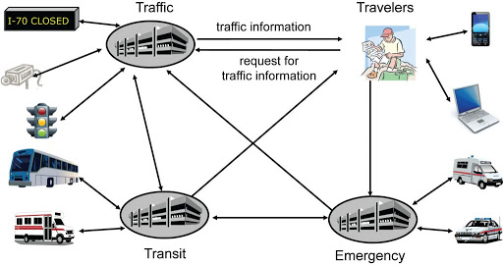
ITS Architecture

Slide 2
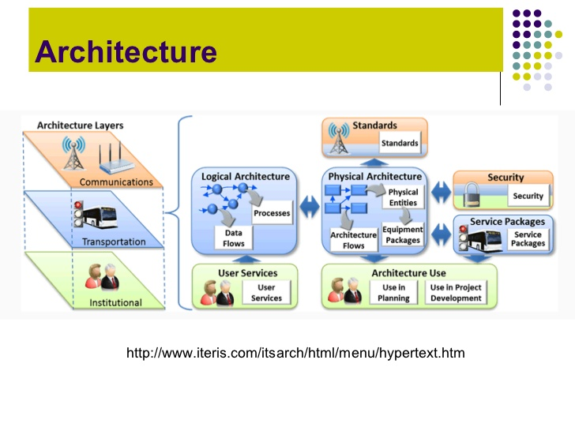

Slide 3
Regional ITS Architecture
A regional ITS architecture shall be developed to guide the development of ITS projects and programs and be consistent with ITS strategies and projects contained in applicable transportation plans.
The National ITS Architecture shall be used as a resource in the development of the regional ITS architecture. The regional ITS architecture shall be on a scale commensurate with the scope of ITS investment in the region.
Provision should be made to include participation from the following agencies, as appropriate, in the development of the regional ITS architecture:
Highway agencies;
public safety agencies (e.g., police, fire, emergency/medical);
transit operators;
Federal lands agencies;
State motor carrier agencies;
other operating agencies necessary to fully address regional ITS integration.

Slide 4
The regional ITS architecture shall include, at a minimum, the following:
A description of the region;
Identification of participating agencies and other stakeholders;
An operational concept that identifies the roles and responsibilities of participating agencies and stakeholders in the operation and implementation of the systems included in the regional ITS architecture;
Any agreements (existing or new) required for operations, including at a minimum those affecting ITS project interoperability, utilization of ITS related standards, and the operation of the projects identified in the regional ITS architecture;
System functional requirements;
Interface requirements and information exchanges with planned and existing systems and subsystems (for example, subsystems and architecture flows as defined in the National ITS Architecture);
Identification of ITS standards supporting regional and national interoperability; and
The sequence of projects required for implementation.

Slide 5
The ITS Architecture provides a common framework for planning, defining, and integrating intelligent transportation systems. The ITS architecture should be common and of specified standards throughout the state or region so that it can address solution to several problems while interacting with various agencies.
Interoperability - The ITS architecture should be such that the information collected, function implemented or any equipment installed be interoperable by various agencies in different state and regions.
Capable of sharing and exchanging information - The information by traffic operations may be useful to the emergency services.
Resource sharing - regional communication towers constructed by various private agencies are required to be shared by ITS operations.

Slide 6
User services and their requirements
Traffic Control provides the capability to efficiently manage the movement of traffic on streets and highways. Four functions are provided which are
(1) Traffic Flow Optimization,
(2) Traffic Surveillance,
(3) Control, and
(4) Provide Information.

Slide 7
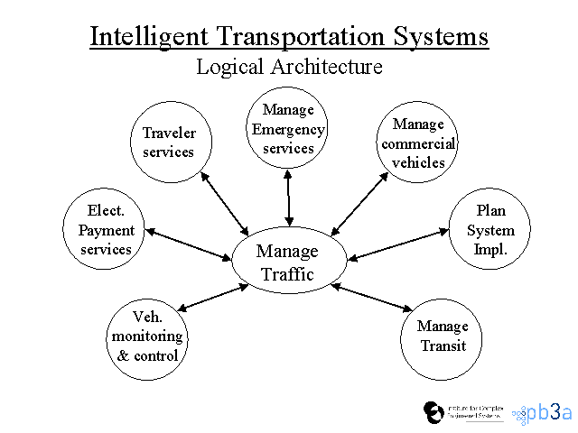
To accomplish user service requirements many functions or processes are needed. The logical architecture defines a set of functions (or processes) and information flows (or data flows) that respond to the user service requirements.

Slide 8
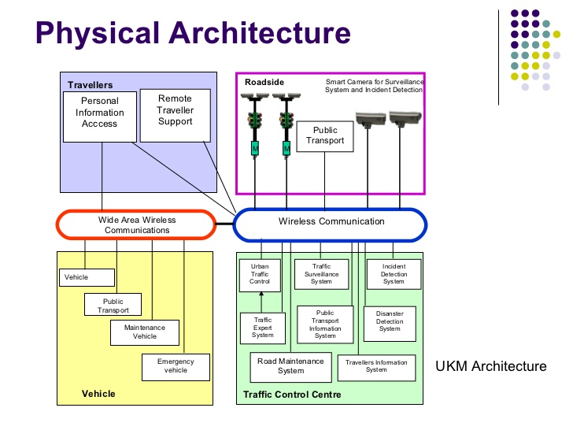

Slide 9
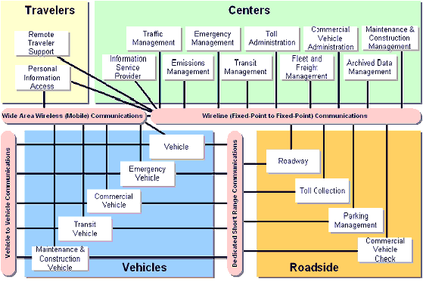
Equipment Package

Slide 10
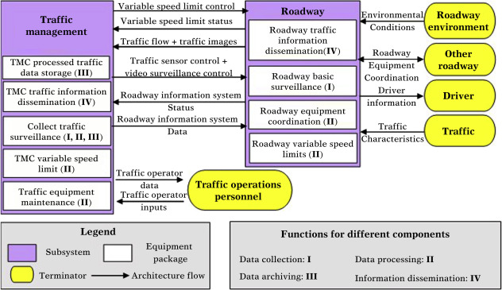
Market Packages

Slide 11
